Slide 1

Maker Space
Kyler Kershaw
Marcus Mitchell
Daniel Bigler
Jessica Prater

Slide 2
Who we are
Kyler
Marcus
Daniel
Jessica

Slide 3
What does the program do?
Inventory management
Scheduling and booking
Logins
Newsletters
Admin access.

Slide 4
Front End
Responsible for designing a making the website look presentable
Having login forms and making it available for customers to sign up and make accounts
Responsible for designing & formatting. Putting info as far as explaining what is a makerspace & how can a person maker their own.

Slide 5
What we’re using
Python
Flask
SQLite
Bootstrap/ HTML

Slide 6
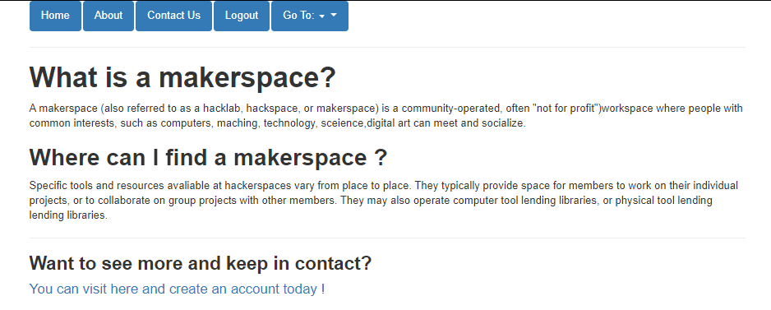
About Maker Space
This page displays a small bit about what a maker space is.

Slide 7
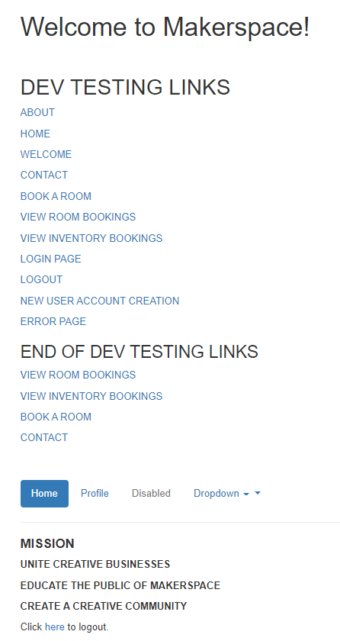
Home
The home page is a DEV testing link page that only admins can see

Slide 8
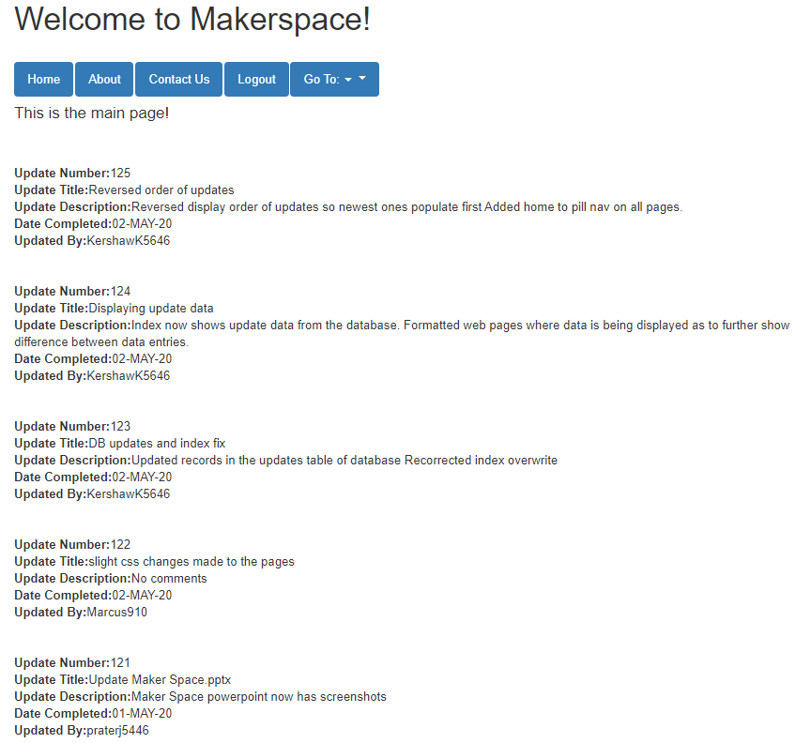
Welcome
The welcome page displays
Login option
Create account option

Slide 9
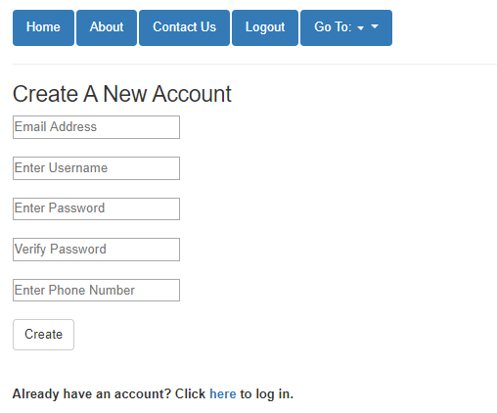
Create Account
Creating an account is a quick and simple process. All that is required are:
Email
Username
Password (as well as password verification)
Phone Number

Slide 10
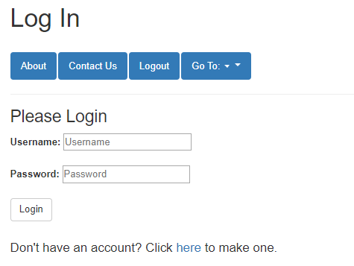
Login
The Login page requires;
Username
Password

Slide 11
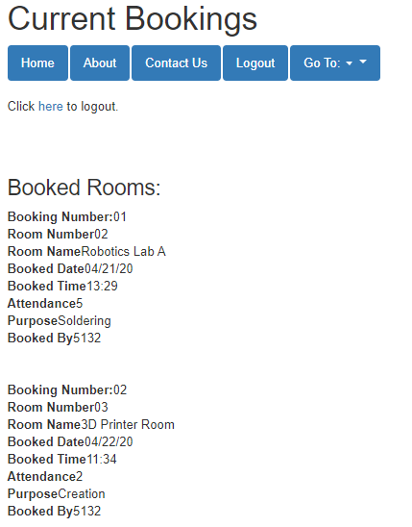
Room Bookings
Room Booking currently shows rooms that are currently booked.

Slide 12
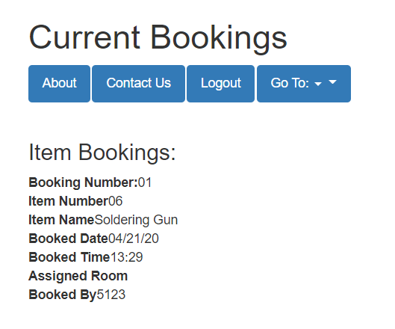
Inventory Bookings
Room Booking currently shows items that are currently booked.

Slide 13
Book a Room
Room Booking currently displays a message about calling to book a room if there are any available rooms that someone may be interested in.

Slide 14
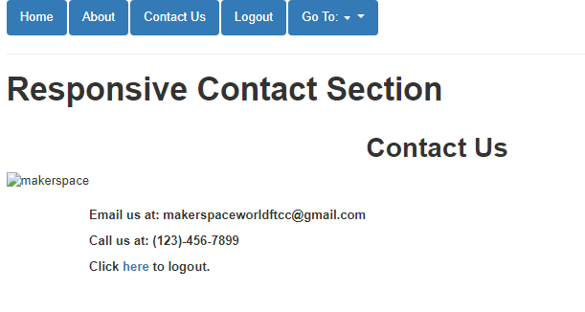
Contact
Contact currently shows contacts of email and phone number to be able to get help or to book a room.

Slide 15
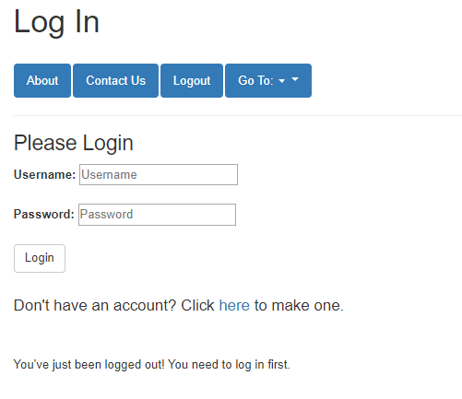
Logout
When you logout, it takes you to the login page and displays a message to show that you have logged out

Slide 16
Q&A
Questions?

